Slide 1
Wirelessly controlled 3D Printed Animatronic Hand Project
Minhazul Islam
Negatu Asmamaw
Anshuman Prasad
Gift Nyikayaramba

Slide 2
Hand fabrication
The hand and forearm were 3D printed
Designs were adopted from the Inmoov robot project

Slide 3
Sensing
The control-glove interfaces with the signal-sending Arduino via flex sensors
The flex sensors are each part of a voltage divider which also consists of a fixed resistance
When the fingers are flexed, node voltages are varied and this information is sent to the robotic arm from the first Arduino via an Xbee bluetooth module

Slide 4
Processing
Signals sent from the first Arduino are received using another Xbee module
Noisy signal is filtered and corrupted data packets are dropped
Signals are then mapped onto a 0 to 180 degree range

Slide 5
Control
Mapped control signals are sent to the corresponding servo motors
Servo motors then directly control the fingers which can each take 8 positions

Slide 6
Applications
Handling harmful substances
Operation in extreme conditions
Remote surgery
Voice-controlled prosthetics (with slight alteration)

Slide 7
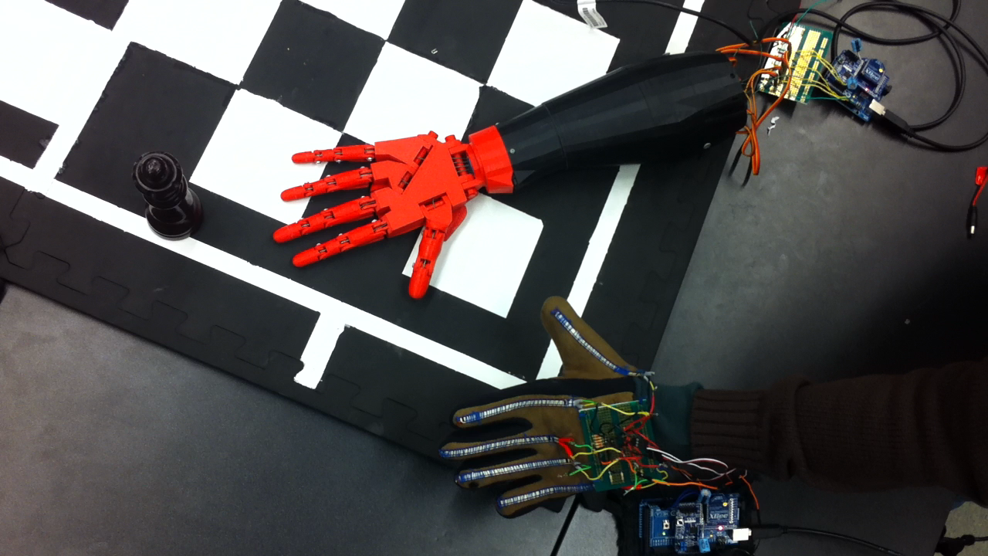

Slide 8
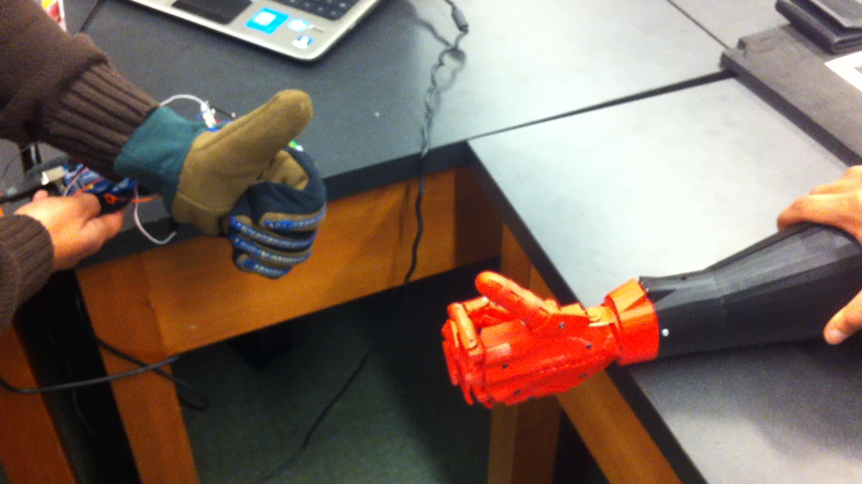

Slide 9
Challenges
Establishing communication between the 2 microcontrollers
Formatting data to be sent conveniently and accurately
Calibrating the flex sensors and the servo motors

